Slide 1
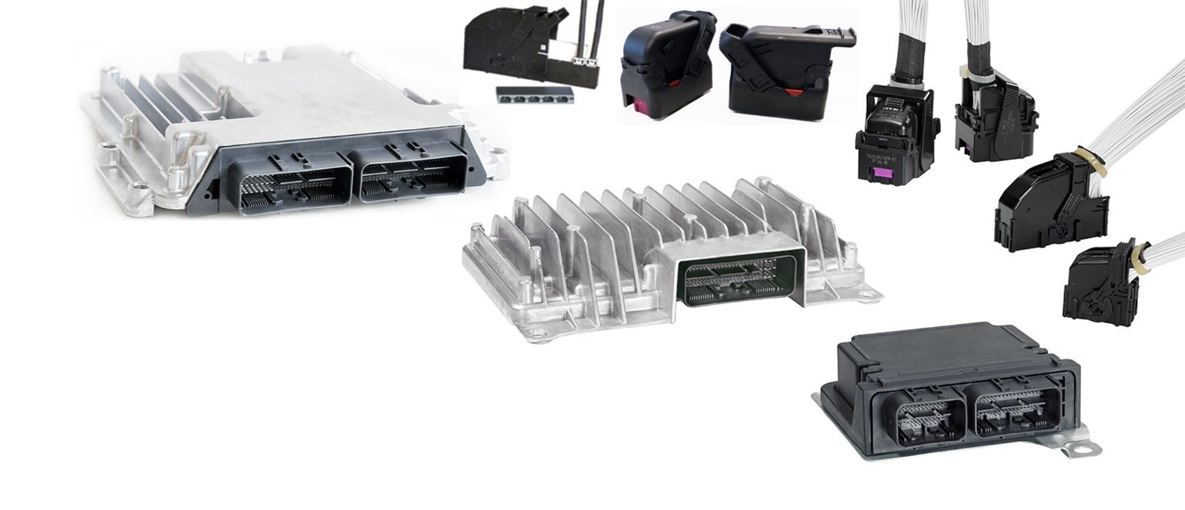
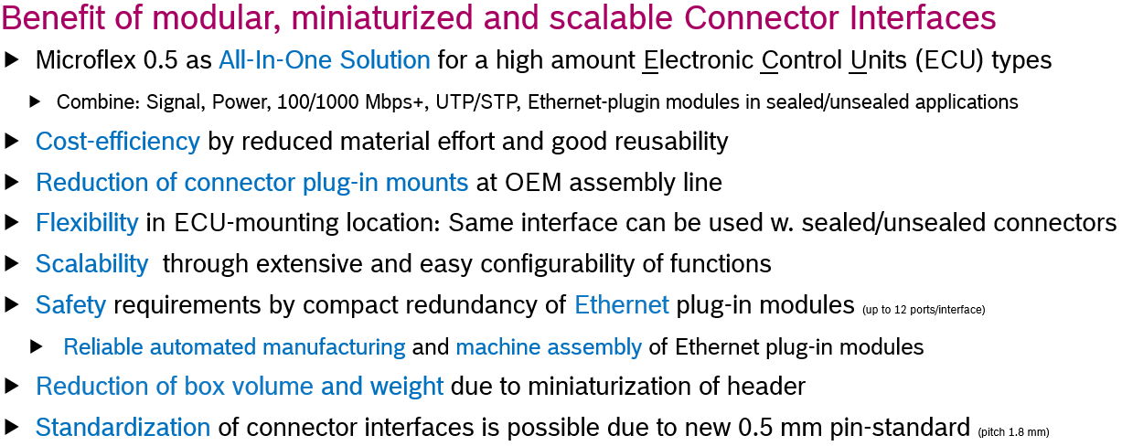
Microflex 0.5 – Innovative compact automotive connector interface
Shown connectors available by BOSCH / Sumitomo
Microflex 0.5 is a compact and flexible automotive open interface with possibility of Ethernet-integration
Microflex 0.5: Miniaturized, flexible interface based on 0.5 mm standardized pins

Slide 2
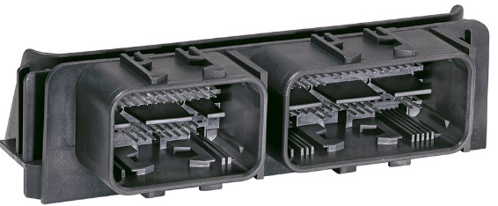
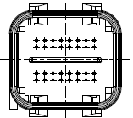
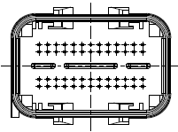
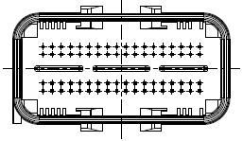
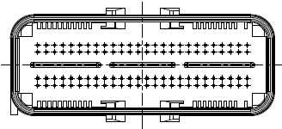
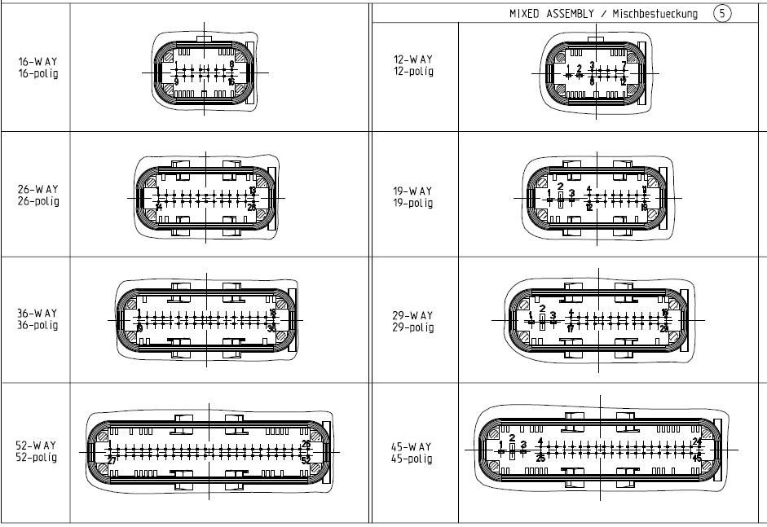
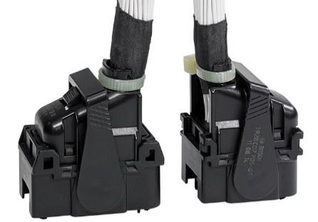
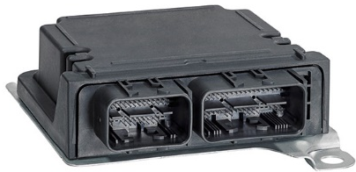
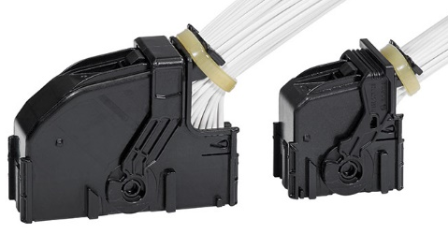
Open Interface - Modular for high flexibility and functionality
Microflex 0.5 – Innovative compact automotive connector interface
4-row Interface modules
Base for:
Standardization
Miniaturization
Ethernet functionality
Modular design, scalability
High flexibility
Equal parts, cost
32 pole
52 pole
72 pole
104 pole
out-side /
in-side Locking geometry for unsealed & sealed harness connectors
2-row Interface modules
Modules with signal pins 0.5x0.4 and
with optional power tabs 1.2x0.6
on same Interface
OPEN INTERFACE: drawing free available
http://bosch-open-interfaces.de
Unsealed harness connector with inside locking
Sealed harness connector with outside locking
ECU with Microflex 0.5 interface (sealed & unsealed)

Slide 3
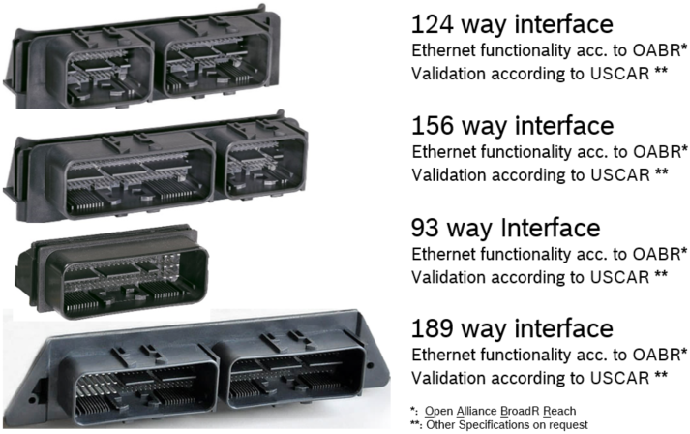
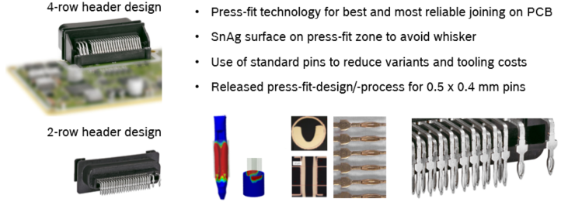
Typical specification of Microflex-interface*
Microflex 0.5 – Innovative compact automotive connector interface
Specification: SAE/USCAR-2 REVISION 6 LV214
Temperature Class: ** (T3) **
Sealing Class: Unsealed / sealed (S1-S3) PG23 (sealed)
Current rating (in connector) 0.5 terminals: 2.5 A / 3.5 A @ 90°C Sn/Ag (0.35 mm²)
1.2 terminals: 5-6 A @ 90°C Sn (0.75 mm²)
Number of Pins: around 200 for 2 module headers
Pin Classes / Surface: 0.5 mm 1.2 mm / Sn***, Ag, Au
Joining technology PCB: Press-Fit technology (preferred)
Ethernet Functionality: acc. to Open Alliance TC2 / TC9
Connector supplier: BOSCH, Sumitomo, APTIV
Typical specification classes for Microflex interface, other specifications on request
System responsibility within the wiring harness connector supplier
*:Specification has to be confirmed by wiring harness connector supplier; **: According to specification of used contact system ; ***: Series

Slide 4
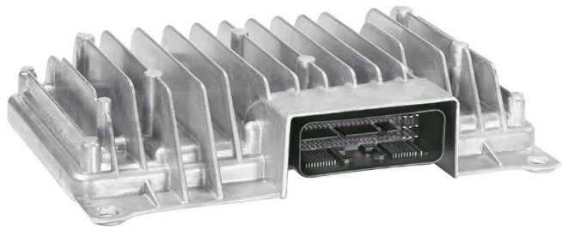
Ethernet-integration in standard Microflex interface
Microflex 0.5 – Innovative compact automotive connector interface
Example with 5 Ethernet ports
Reduction of plug-ins
(red. interface-amount)
Flexible mounting place
(interface: sealed / unsealed)
Re-use: Pins, connectors,
headers
Reduction of material
(metal / coating / plastic)
Miniaturization
(reduced box volume, more PCB-space)
Standardization
(new pin- / interface-standard)
5.5 cm
All-In-One Interface
9x Power
42x Signal
5x Ethernet
sealed /unsealed
  Ethernet connectivity which reduces the amount of interfaces/connector plug-in mounts at the OEM
  Usable for sealed and unsealed connectors combined with compactness and functional integration
  Flexibility and scalability of Ethernet function without change of design in standard 4-row/2-row interfaces

Slide 5
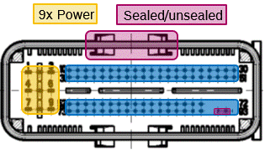
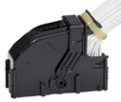
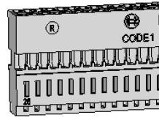
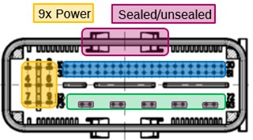
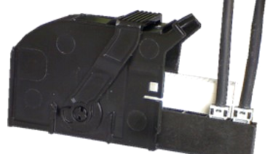
Flexible wiring harness concepts - standard vs. modular design
Microflex 0.5 – Innovative compact automotive connector interface
twisted pair cable
Microflex 0.5 All-In-One Interface
 | sealed | unsealed
100BASE-T1
1000BASE-T1
UTP
STP/SPP
Signal
Power
contact carrier
“standard”: 100 Mbps
0 – 5 x 100 Mbps → 76 – 44 Std. signal pins
Ethernet
twisted pair cable
Modular contact carrier design for plug-in modules automatic assembly possible
“modular”:
100 Mbit/s / 1 Gbps
Typical UTP & STP Ethernet cables
(e.g. Kroschu Krocar 6499-6795, Leoni Dacar 647-4)
0 – 5 x 100(0) Mbps → 74 – 42 Std. signal pins
Standard application (100 Mbps/UTP)
Modular design for twisted pair cables w. option for automated assembly (100 Mbps/1 Gbps w. UTP/STP )
Development ongoing for Multi-Gig Ethernet application (up to 10 Gbit/s)

Slide 6

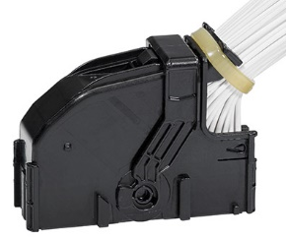
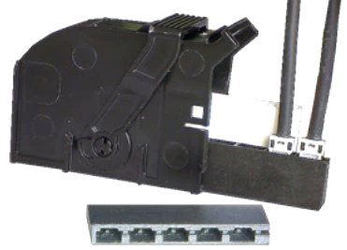
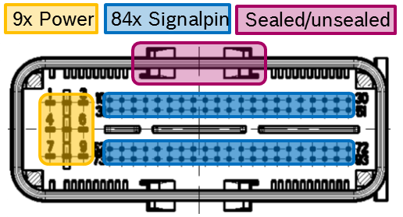
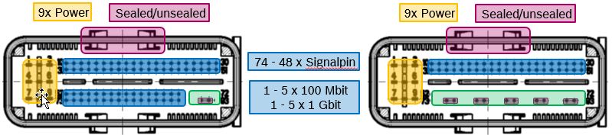
Scalability of Ethernet ports – 100 Mbps / 1Gbps (Example)
Microflex 0.5 – Innovative compact automotive connector interface
twisted pair cable
Contact carrier modular design
100 Mbps: unshielded (plastic)
1 Gbps: shielded (metal)
scalable to
Example Interface
no Ethernet-port
1 Ethernet-port
5 Ethernet-ports
74 -48 x Signalpin
0 – 5 x 100 Mbps
0 – 5 x 1 Gbps
Ethernet
Ethernet
Full scalability of Ethernet ports – modular design for easy application and save function

